Slide 1


Data Warehouse and Pandas
SUBMITTED TO : Mr. C V S N REDDY
SUBMITTED BY : TEJAAL M
USN : ENG19CS0334
SEMESTER : 5
YEAR : III
SECTION : F

Slide 2


Data Science
Theories and techniques from many fields and disciplines are used to investigate and analyze a large amount of data to help decision makers in many industries such as science, engineering, economics, politics, finance, and education
Computer Science
Pattern recognition, visualization, data warehousing, High performance computing, Databases, AI
Mathematics
Mathematical Modeling
Statistics
Statistical and Stochastic modeling, Probability.

Slide 3
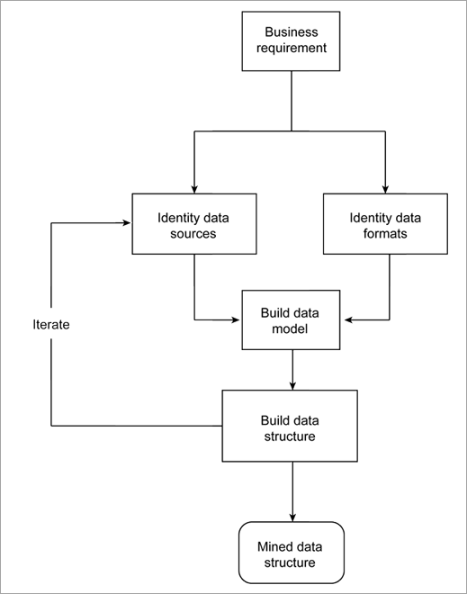
STAGES OF DATA MINING
STAGES OF DATA PREPROCESSING
Data Cleaning
Data Integration
Data Reduction
Data Transformation
Data Mining
Pattern Evaluation
Knowledge Representation

Slide 4
Data Warehouse
Data Warehouse
A data warehouse is a large collection of business data used to help an organization make decisions
Refers to a place where data can be stored for useful mining. It is like a quick computer system with exceptionally huge data storage capacity.
ETL is a process in Data Warehousing and it stands for Extract, Transform and Load. It is a process in which an ETL tool extracts the data from various data source systems, transforms it in the staging area, and then finally, loads it into the Data Warehouse system.
Extraction:
Data from various source systems is extracted which can be in various formats like relational databases, No SQL, XML, and flat files into the staging area.
Loading it directly into the data warehouse may damage it and rollback will be much more difficult.
2. Transformation:
Filtering – loading only certain attributes into the data warehouse.
Cleaning – filling up the NULL values with some default values.
Joining – joining multiple attributes into one.
Splitting – splitting a single attribute into multiple attributes.
Sorting – sorting tuples on the basis of some attribute (generally key-attribute).
3. Loading:
The transformed data is finally loaded into the data warehouse. Sometimes the data is updated by loading into the data warehouse very frequently and sometimes it is done after longer but regular intervals.

Slide 5
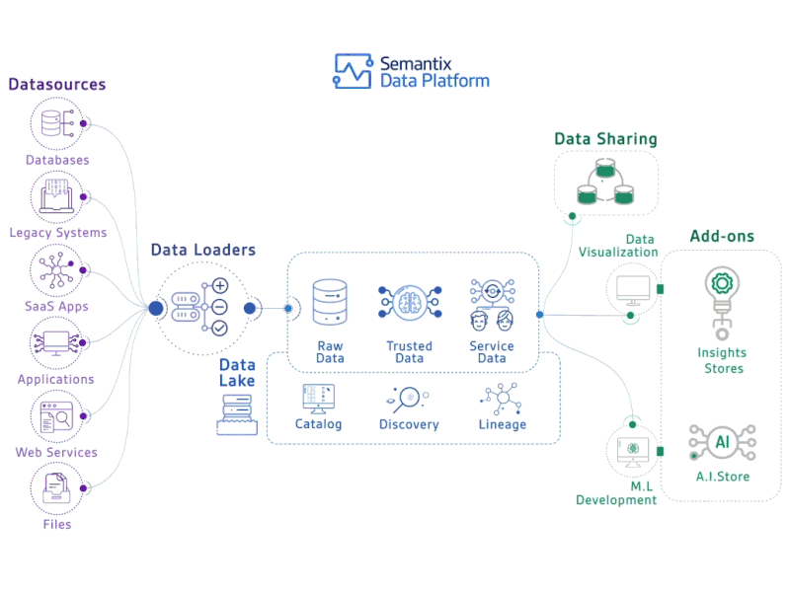
ETL

Slide 6
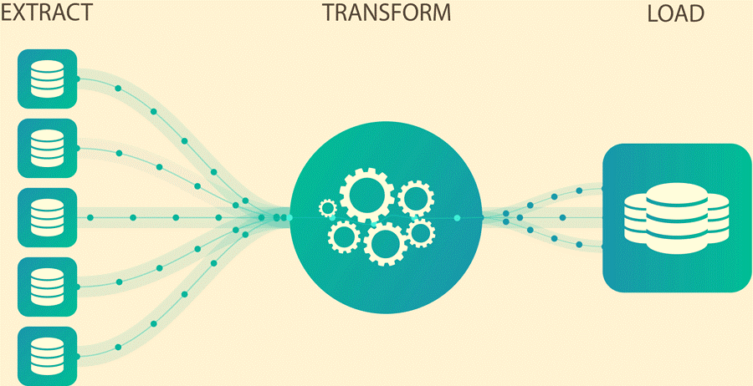



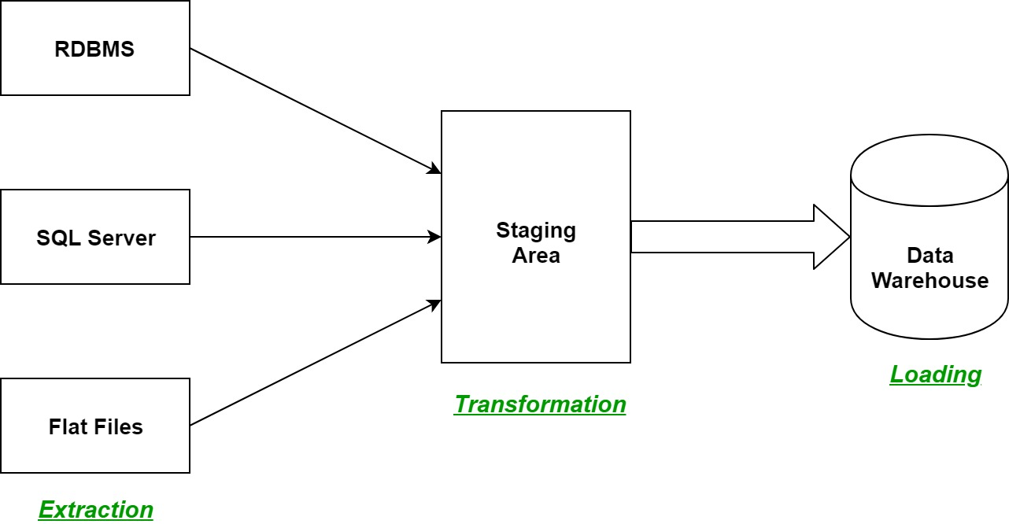
ETL Process
EXTRACTION
TRANSFORMATION
LOAD

Slide 7
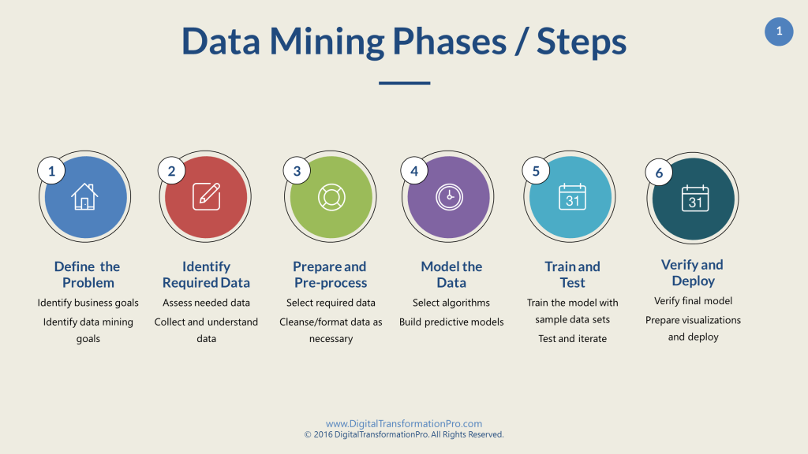
Data Mining
Data mining refers to the analysis of data.
Data mining, also known as knowledge discovery in data (KDD), is the process of uncovering patterns and other valuable information from large data sets.
In the data mining process, the computer analyzes the data and extract useful information from it.
It looks for hidden patterns within the data set and try to predict future behavior.
Data mining is primarily used to discover and indicate relationships among the data sets.

Slide 8
Data Mining Applications
Sales and marketing
Companies collect a massive amount of data about their customers and prospects. By observing consumer demographics and online user behavior, companies can use data to optimize their marketing campaigns, improving segmentation.
Predictive analyses can also help teams to set expectations with their stakeholders, providing yield estimates from any increases or decreases in marketing investment.
Education
Educational institutions have started to collect data to understand their student populations as well as which environments are conducive to success.
As courses continue to transfer to online platforms, they can use a variety of dimensions and metrics to observe and evaluate performance, such as keystroke, student profiles, classes, universities, time spent, etc.
Operational optimization
Process mining leverages data mining techniques to reduce costs across operational functions, enabling organizations to run more efficiently.
This practice has helped to identify costly bottlenecks and improve decision-making among business leaders.
Fraud detection
While frequently occurring patterns in data can provide teams with valuable insight, observing data anomalies is also beneficial, assisting companies in detecting fraud.
While this is a well-known use case within banking and other financial institutions, SaaS-based companies have also started to adopt these practices to eliminate fake user accounts from their datasets.

Slide 9
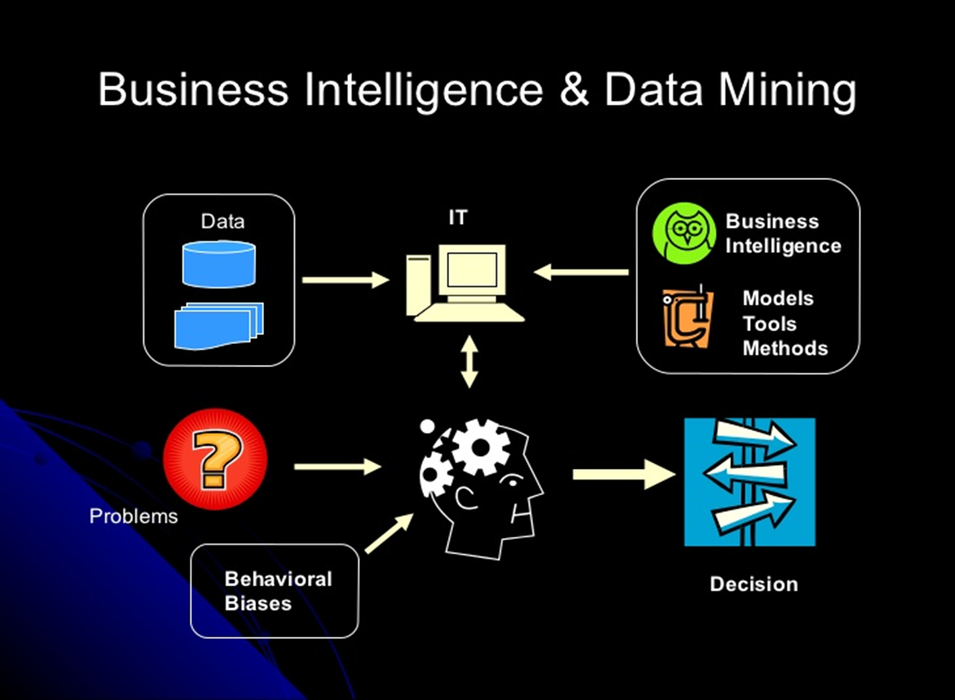
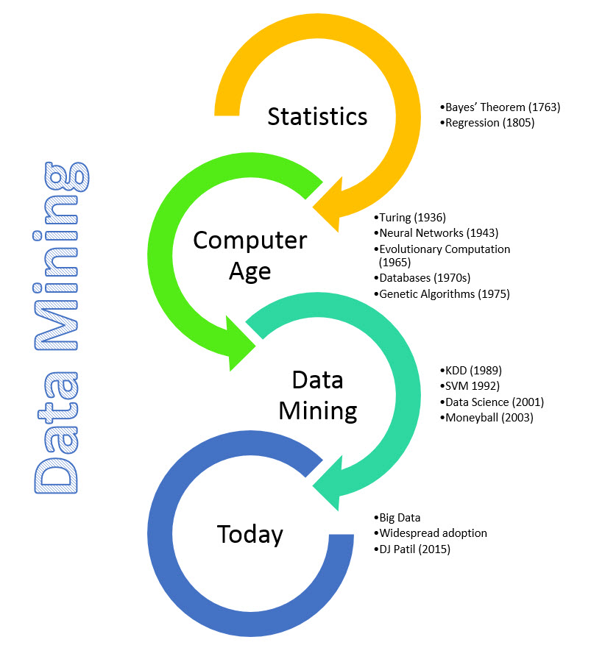
Data Mining Applications

Slide 10
Big Data
Big Data is any data that is expensive to manage and hard to extract value from .
Volume
The size of the data.
Velocity
The latency of data processing relative to the growing demand for interactivity.
Variety and Complexity
The diversity of sources, formats, quality, structures.
d
d
d
V
V
V

Slide 11

Data visualization is the practice of translating information into a visual context, such as a map or graph, to make data easier for the human brain to understand and pull insights from.
The main goal of data visualization is to make it easier to identify patterns, trends and outliers in large data sets.
The term is often used interchangeably with others, including information graphics, information visualization and statistical graphics.
After data has been collected, processed and modeled, it must be visualized for conclusions to be made.
Data visualization is also an element of the broader data presentation architecture (DPA) discipline, which aims to identify, locate, manipulate, format and deliver data in the most efficient way possible.
When a data scientist is writing advanced predictive analytics or machine learning (ML) algorithms, it becomes important to visualize the outputs to monitor results and ensure that models are performing as intended.
This is because visualizations of complex algorithms are generally easier to interpret than numerical outputs.
Data Visualization

Slide 12
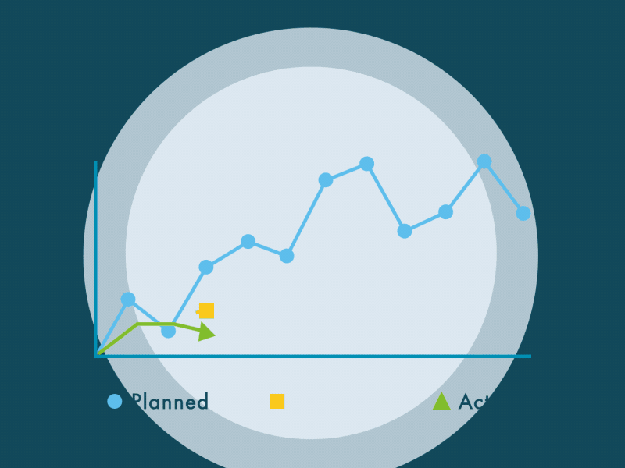




Why data visualization is important ?
See the big picture
Uncover insights and see patterns within complex data without relying on a data scientist.
Make better decisions
Understand your next steps and spend less time performing data analysis. Quickly act on decisions.
Present meaningful data
Share insights with others in an easy-to-understand form.
Democratize your data
Provide one source of truth for your entire organization.

Slide 13
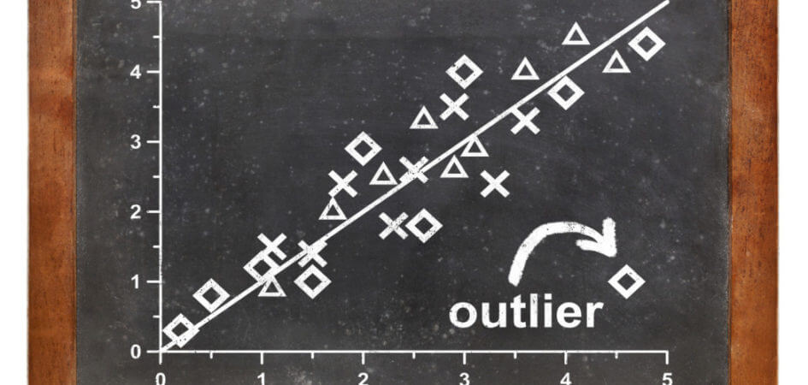

Outliers are data points that are far from other data points. They're unusual values in a dataset. First, we have to ask ourselves how that outlier came to exist? > Data entry error? > An accidental response that was recorded correctly? > Intentional misrepresentation? > A correct value that we simply didn’t expect? So how do we know which it is? We can: >Keep them and make a note >Replace them with mean/median data >Transform the data
Data Outliers

Slide 14
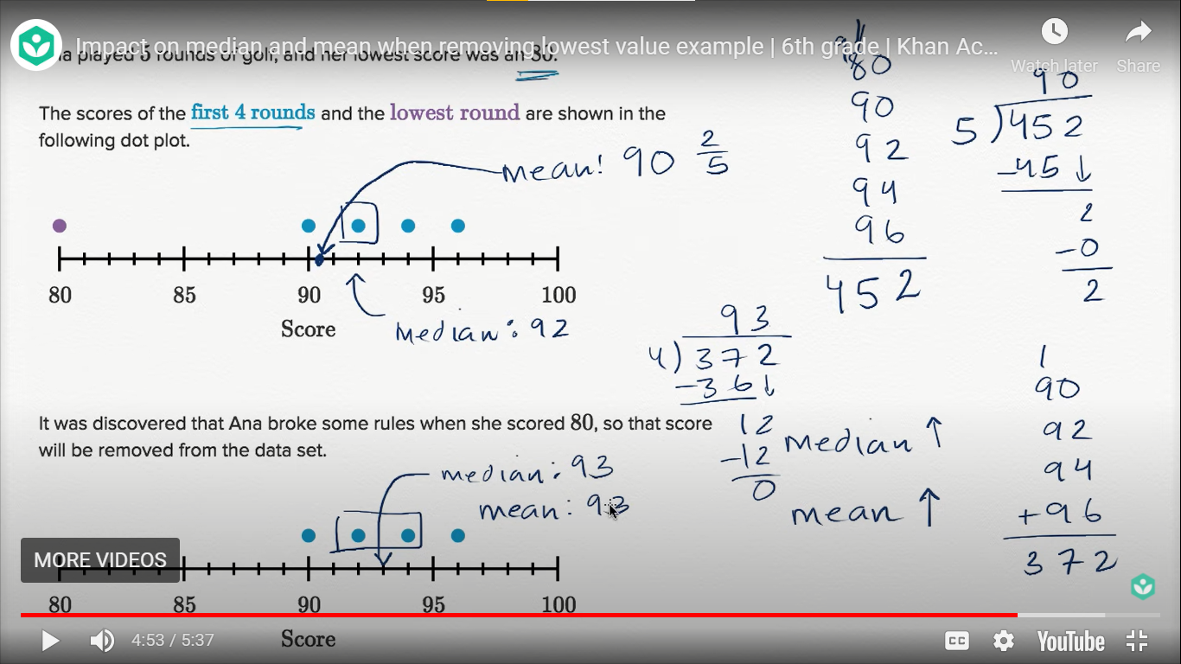
WHAT DISCARDING OUTLIERS CAN DO TO OUR RESULTS?

Slide 15

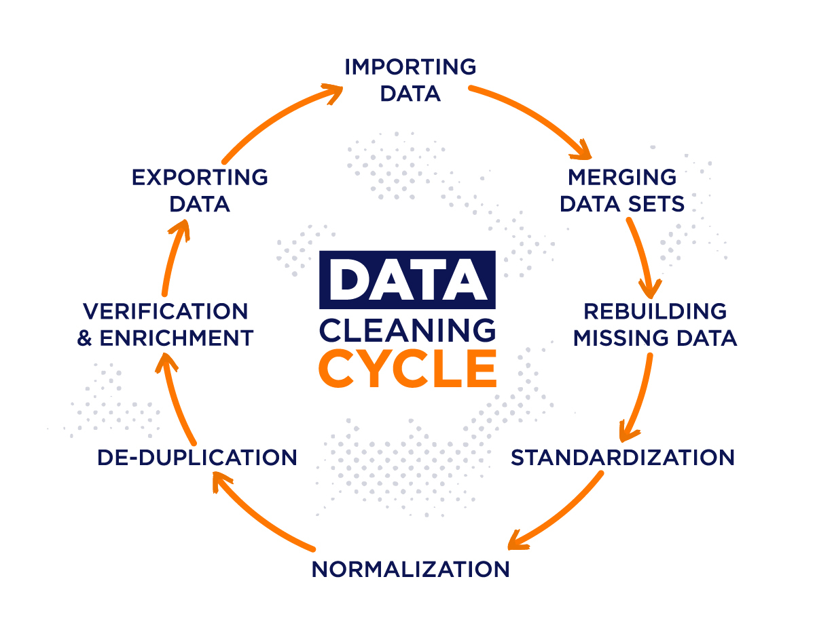
Data cleaning is the process of fixing or removing incorrect, corrupted, incorrectly formatted, duplicate, or incomplete data within a dataset.
Data cleaning is the process that removes data that does not belong in your dataset. Data transformation is the process of converting data from one format or structure into another.
Transformation processes can also be referred to as data wrangling, or data munging, transforming and mapping data from one "raw" data form into another format for warehousing and analyzing.
How do you clean data?
Step 1: Remove duplicate or irrelevant observations
Step 2: Fix structural errors
Step 3: Filter unwanted outliers
Step 4: Handle missing data
Step 5: Validate and QA
Data Cleaning
Notes:
https://www.tableau.com/learn/articles/what-is-data-cleaning

Slide 16





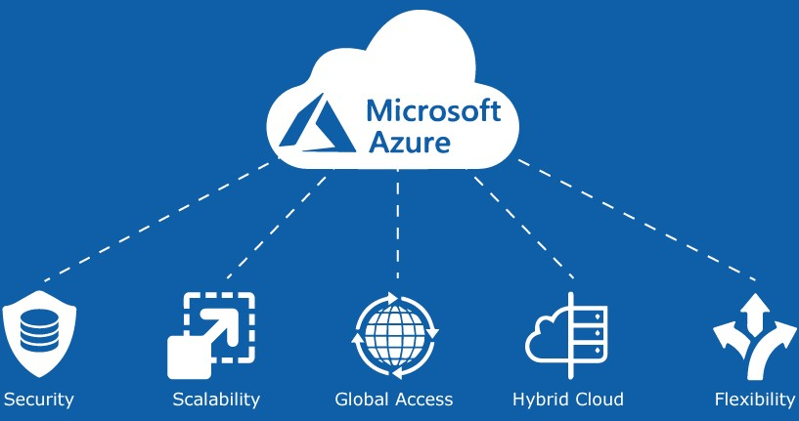


Data Science Tools
Following are some tools required for data science:
Data Analysis tools: R, Python, Statistics, SAS, Jupyter, R Studio, MATLAB, Excel, RapidMiner.
Data Warehousing: ETL, SQL, Hadoop, Informatica/Talend, AWS Redshift
Data Visualization tools: R, Jupyter, Tableau, Cognos,Pandas.
Machine learning tools: Python,Mahout, Azure ML studio.

Slide 17
ABOUT PANDAS
Refer to the document in github
ANALYSE DATA
Cleaning Data
Clean Data
Clean Wrong Data
Remove Duplicates
Clean Empty Cells
Clean Wrong Format
ADVANCED
Correlations
Plotting
Notes:
Github https://github.com/ENG19CS0334-TEJAAL-M/DEEP-LEARNING-PROGRAMS/blob/main/Seminar/About_pandas.ipynb

Slide 18

References
.
https://www.w3schools.com/python/pandas/default.asp
https://github.com/ENG19CS0334-TEJAAL-M/DEEP-LEARNING-PROGRAMS/blob/406632fa4bed49d4359e3cc220218ee72944a604/Seminar/About_pandas.ipynb
https://www.geeksforgeeks.org/etl-process-in-data-warehouse/
https://www.tableau.com/learn/articles/what-is-data-cleaning
https://searchbusinessanalytics.techtarget.com/definition/data-visualization
https://www.ibm.com/cloud/learn/data-mining
https://www.geeksforgeeks.org/etl-process-in-data-warehouse/
THANK YOU
Tejaal M
ENG19CS0334

